Slide 1


Slide 2
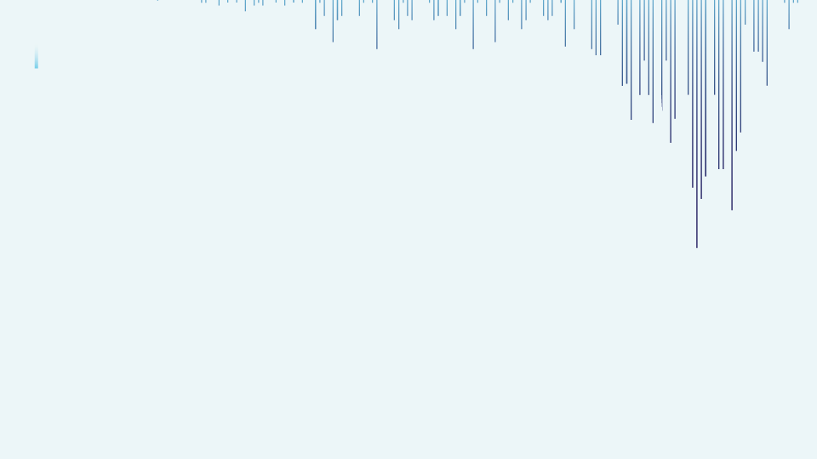

🎬 Predicting Movie Success using Machine Learning
In the realm of entertainment analytics, this project focuses on the strategic enhancement of prediction models through machine learning techniques. By narrowing our focus on movie success prediction, we aim to drive innovations that could reshape investment decisions, optimize production strategies, and elevate audience engagement through data-driven insights.
Presented By :Syed Abdul Raheem

Slide 3
INTRODUCTION
Movie success prediction is a complex and impactful task in the entertainment industry, driven by various features ranging from cast popularity to production budgets. Early prediction of a film's success can assist producers, investors, and marketers in making strategic decisions.
This project leverages a comprehensive dataset of movies, capturing diverse indicators such as actor popularity, director ratings, budget, genres, Facebook likes, IMDb scores, and more.
The dataset comprises 27+ features that influence the performance of a movie, and our goal is to build a machine learning model to predict whether a movie is likely to be successful or not based on these features.
The target variable, "Success Label", indicates the predicted success of a movie — classified as either a Hit or Flop based on specific criteria such as revenue, ratings, and audience engagement.

Slide 4
Project Objective
Predict movie success category (Flop, Average, Hit) using machine learning.
Business Motivation: Help producers & investors decide on profitable movies.
Dataset Overview: Bollywood + Hollywood movies with key features like IMDb, Budget, Facebook likes, etc.

Slide 5


Monitor and Update (Optional)
STEP
07
Continuously monitor the model's performance in the real-world scenario
Model Evaluation
STEP
06
Assessing the performance of a machine learning model using metrics
Model Selection and
Model Training
STEP
Choosing a suitable machine learning algorithm and optimizing its parameters
05
Split Train And Test Data
WORK FLOW
WORK FLOW
STEP
04
Dividing the dataset into training and testing sets to evaluate
PREPROCESSING
STEP
Preparing and cleaning data to enhance its quality and suitability
03
Exploratory Data Analysis
STEP
02
Analyzing and visualizing data patterns to understand its characteristics
Data Collection
STEP
Gathering and organizing data to train machine learning models.
01

Slide 6
Dataset Summary
Total Records: 5043 Movies
Features Used: 27 (e.g., duration, genres, budget, IMDb score, etc.)
Target Variable: “success_class” → (based on ‘imdb_score’)
Preprocessing Steps: ✓ Target Variable Created (Binary Classification) ✓ Irrelevant Features Removed ✓ Missing Values Handled ✓ Categorical Features Encoded (LabelEncoder / OneHotEncoder) ✓ Outliers Detected & Treated ✓ Feature Scaling Applied (StandardScaler) ✓ Skewness Handled (for non-normal features)

Slide 7
EXPLORATORY DATA ANALYSIS
Exploratory Data Analysis (EDA) helped us understand the overall structure of the movie dataset, find hidden patterns, and discover useful trends.
We explored the distribution of all features and checked how different variables are related to each other and the target — movie success.
Visualizations made it easier to understand relationships between features like budget, IMDb score, genres, and more — and how they impact a movie’s success.
Our dataset was clean (no missing values), but we found some duplicate records and outliers.
We used univariate and bivariate analysis to understand each feature individually and how it connects to our main goal — predicting the movie’s success.

Slide 8
1. DISTRIBUTION OF CONTINUOUS VARIABLE
Budget: Most movies had budgets ranging from $10M to $60M, though some high-budget outliers were present, particularly for blockbuster productions.
Duration: The majority of movies ranged between 90–120 minutes, with an average of approximately 106 minutes, reflecting standard feature film lengths.
IMDb Score: The scores were nearly normally distributed, centered around a mean of 6.4, with most movies falling between 5.5 and 7.5.
Cast & Director Facebook Likes: The distribution was right-skewed, with most entries having fewer than 1,000 likes, but several popular actors/directors reached up to 20,000+ likes.
User Votes & Reviews: Strong positive skew observed; while most movies had fewer than 50,000 votes, a few achieved over a million votes, indicating fan-favorite or blockbuster status.
Gross Revenue: Though not the target variable, it showed a skewed distribution as well. Most movies grossed under $100M, with a few exceeding $300M.

Slide 9
2. CONTINUOUS FEATURES vs TARGET Variable (imdb_score/success_class)
Budget vs Success: Movies with higher budgets more frequently belonged to the High success category, indicating strong production value.
IMDb Score vs Success: Naturally aligned with the target class, but the trend still confirmed a direct correlation between higher IMDb scores and success class.
Duration vs Success: Movies lasting between 100–120 minutes were more likely to fall into the Medium to High success classes.
User Votes & Reviews: Movies with greater audience interaction (high number of votes/reviews) tended to belong to the High success category.
Cast Facebook Likes: A strong cast with a large social media following was positively associated with movie success.

Slide 10
3. Distribution of Categorical
Variables
Genres: The most common genres were Drama, Comedy, and Action, with many movies listed under hybrid genres such as Action|Adventure.
Language: The dataset was heavily dominated by English-language films, with a small proportion of non-English movies.
Country: USA was the leading country in terms of production, followed by the UK, Canada, and India.
Content Rating: The most frequent ratings were PG-13, R, and PG, although some entries had missing or unspecified ratings.
Color: The overwhelming majority of films were color movies, with very few black-and-white entries.

Slide 11
4. Categorical FEATURES vs TARGET Variable (imdb_score/success_class)
Genres vs Success: Genres such as Action, Sci-fi, and Thriller had a higher tendency to be in the High success class, whereas Drama or Documentary genres leaned toward Low or Medium success.
Language vs Success: English-language movies were dominant in the High success class. Non-English films generally had lower success rates.
Content Rating vs Success: Movies rated PG-13 and R were more likely to be in the High success category, possibly due to broader audience appeal.
Country vs Success: USA-based films were more likely to be in the High success class, potentially due to better resources and global appeal.
Color vs Success: All movies classified under High success were in color. Black & white movies were rare and did not achieve high success.

Slide 12
5. Correlation with Target Variable (imdb_score/success_class)
Strong Positive Correlation ( > 0.5 ) “num_voted_users →” 0.80
Indicates a strong relationship. Movies with more votes tend to receive higher IMDb ratings.
Moderate to Low Positive Correlation ( 0.2 – 0.5 )
Gross -> 0.41
num_critic_for_reviews -> 0.31
num_user_for_reviews -> 0.29
duration -> 0.26
cast_total_facebook_likes -> 0.26
movie_facebook_likes -> 0.25
These features show a moderate relationship with IMDb score. While not highly influential, they still contribute to prediction.
Weak or No Correlation ( -0.2 – 0.2 )
director_facebook_likes → 0.17
actor_1_facebook_likes → 0.08
actor_2_facebook_likes → 0.08
actor_3_facebook_likes → 0.05
title_year → 0.05
aspect_ratio → 0.06
Budget → 0.03
facenumber_in_poster → -0.07
These variables show little to no linear correlation with IMDb score.

Slide 13

PREPROCESSSING
Irrelevant Feature Removal: Based on Exploratory Data Analysis (EDA), all features in the dataset were found to be potentially relevant for predicting movie success. Hence, no columns were dropped at this stage to avoid losing any valuable information, especially given the dataset’s modest size
Missing Value Treatment: Several features such as (e.g: budget, gross, content_rating, title_year etc ) had missing values. These were handled appropriately using mean imputation for numerical columns and mode imputation for categorical columns to ensure data completeness.
Outliers Treatment: Outliers in continuous features (e.g: gross, budget, duration etc) were detected using the IQR method. Due to the nature of some machine learning algorithms and limited dataset size, we opted not to drop them. Instead, Box-Cox transformation was applied to reduce their effect and bring distributions closer to normal.
Categorical Feature Encoding: Applied One-Hot Encoding to nominal categorical columns such as genres, language and content_rating to prepare the data for machine learning algorithms.
Feature Scaling: Scaling was considered important for distance-based and gradient-based models (e.g., Logistic Regression, SVM), while skipped for tree-based models like Decision Tree and Random Forest due to their scale-invariance. To manage both, scaling was handled using pipelines where necessary.

Slide 14
Steps of Preprocessing
Target Creation: Created a new categorical target variable success_class based on IMDb score ranges to enable classification modeling.
Feature Selection: All columns were reviewed for relevance. Only non-predictive identifiers (like movie_title, movie_imdb_link) were dropped to retain maximum useful information.
Missing Values: Missing values in features like (e.g. budget, gross, content_rating etc )were handled using suitable imputations (mean/mode), ensuring a complete dataset.
Categorical Encoding: Applied Label Encoding on nominal variables (e.g. language, country, content_rating and director_name) and One-Hot Encoding applied (e.g. genres) for algorithm compatibility.
Outlier Handling: Outliers detected via IQR method. Due to dataset size and model sensitivity, we avoided dropping them and used Box-Cox transformation to reduce their impact.
Feature Scaling: Used StandardScaler for algorithms sensitive to magnitude (e.g., SVM, Logistic Regression). Skipped for tree-based models using pipeline strategy.
Skewness Treatment: Applied log and Box-Cox transformations on right-skewed features (like gross, budget) to normalize distribution and enhance model accuracy.

Slide 15
TRAIN TEST SPLIT
We divided the data into training (80%) and testing (20%) sets.
Setting a random state ensures consistent results and using stratify=y maintains a proportional distribution of the target variable in both sets.
SPLITING THE DATA INTO X & Y
We divided the dataset into two parts: X and y.
"X" typically represents the independent Variables, and "y" represents the Dependent (target variable) that we want to predict or understand.

Slide 16
MODEL SELECTION
Models used:
Logistic Regression: logistic Regression is commonly used for binary classification problems. it's preferred because it provides a simple an efficient way to model the relationship between the independent variables and the probability of a certain outcome.
Decision Tree: Decision Tree algorithms are used for classification because they are simple, computationally efficient, and effective in handling high-dimensional data.
Works best for categorical independent columns.
Support Vector Machine: SVM is a powerful supervised algorithm that works best on smaller datasets but on complex ones. Support Vector Machine(SVM)can be used for both regression and classification tasks, but generally, they work best in classification problems.
Random Forest Algorithm: Random Forest: Random Forest is a robust supervised algorithm suitable for both regression and classification tasks.

Slide 17
Accuracy
Precision
Recall
F1-Score
%
%
%
%
Understanding
Decision Tree | 100 | 100 | 100 | 100
Random Forest Classifier | 100 | 100 | 100 | 100
Logistic Regression | 96 | 93 | 95 | 94
SVM Tuned | 95 | 91 | 94 | 92
Precision: The accuracy of the model when it claims to have found something.
Recall: Recall: The ability of a model to find all the relevant cases
F1 Score: A balance between recall and precision, useful when both false positives and false negatives need to be minimized.
Experimental Results :
Decision Tree & Random Forest Classifier Dominates: Both algorithms are excels with 100% accuracy, balanced precision (100%) and recall (100%), showcasing superior overall performance.
Percentage (%)
Support Vector Machine Tuned Model Consistency: This algorithm maintain 95% accuracy, with SVM having higher precision (91%) and higher recall also (94%).
Logistic Regression: LR achieves 96% accuracy and precision (93%) and heigher recall (94%).

Slide 18
Conclusion
1. Key Findings
The most influential feature found was ‘num_voted_users’ showing the strongest positive correlation (~0.8) with ‘imdb_score’. — > making it the most powerful predictor of movie success.
Other significant features included:
“ imdb_score, movie_facebook_likes, cast_total_facebook_likes, num_critic_for_reviews, duration and gross “.
Based on our step-by-step model comparison:
Decision Tree gave 100% accuracy on the test set after hyperparameter tuning.
Random Forest also gave 100% accuracy, showing strong generalization ability.
Logistic Regression performed well but slightly behind tree-based models.
SVM showed strong performance, but with higher computation time.
Outliers were treated using Box-Cox Transformation instead of removal, due to small dataset size and algorithm sensitivity.
One-Hot Encoding was used for nominal variables (like genres, language, country ).
Feature scaling was applied using pipelines, especially for models like Logistic Regression and SVM.
Final model evaluation was done using cross-validation and confusion matrices for each algorithm.

Slide 19

2. Limitations
Dataset was relatively small, limiting the generalizability of results.
Some features like gross, budget, facenumber_in_poster and content_rating had missing values, which were imputed, possibly affecting model reliability.
The target variable was manually created (classification of imdb_score into success categories), which might include bias or arbitrariness.
Textual data like ‘plot_keywords’ were not deeply analyzed due to time/scope limitations.
The model was trained and validated on the same dataset (no external data used for validation).
3. Future research
Integrate external data like YouTube trailer views, Twitter buzz, or critic sentiments for a richer feature set.
Use NLP techniques to extract context from plot_keywords, little and reviews.
Try deep learning models (like LSTM or transformers) to capture complex nonlinear patterns, especially from text features.
Explore regression-based approaches as an alternative to classification, using continuous IMDb score or revenue.
Evaluate models on a real-time dataset or through API-based movie data (like OMDB, TMDB) for validation and deployment.

Slide 20


